Slide 1
Graphical User Interfaces (GUI)
Version 3 – Decembre 2009

Slide 2
History
Abstract Window Toolkit (AWT)
  Original GUI API
  Rely on native OS components
Java Foundation Classes (JFC)
  Since Java 1.2
  Includes: AWT, Swing (Widget toolkit), Java 2D
  Lightweight
  System independent

Slide 3
Swing
Widget Toolkit
  a widget (or control) is an element of a GUI that conveys information and/or represent a point of interaction
Model-View-Controller pattern
Pluggable look-and-feel

Slide 4






MVC
Event
Update
View
Controller
Get data
Operate
Model

Slide 5

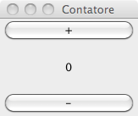

MVC example
bottonePiuClick(){
ilContatore.incrementa();
view.aggiorna();
}
bottoneMenoClick(){
ilContatore.decrementa();
view.aggiorna();
}
class Contatore{
private int valore;
public void incrementa(){ valore++;}
public void decrementa(){ valore--;}
public int getValore(){ return valore;}
}

Slide 6
MVC Principles
When building GUIs we must consider two main aspects:
  Layout (View): how to place the graphical elements to achieve a give visual aspect
  Events (Controller): which behavior associate to elements’ events
Application logic (Model) must remain, as far as possible, separate from user interface.

Slide 7
Execution flow
There is no predefined order of execution in GUIs
  Operation are performed in response to external events (e.g. mouse click)
  Event handling is serialized
  To execute operations in parallel threads must be used
Method main in GUIs has the only goal of instantiating the graphical elements

Slide 8
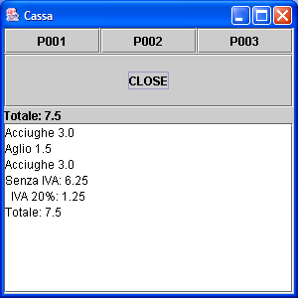
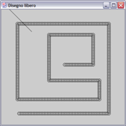
GUI categories
It is possible to identify two extreme types of GUIs:
  Component composition
  Direct drawing
In practice a mix of the two is used.
Components
Direct drawing

Slide 9
GUI with Components
Use predefined UI components (widgets or controls)
  E.g. buttons, text fields, labels
They manage mostly textual information
  Suitable to build an application that could “theoretically” make it with a textual user interface

Slide 10
GUI with drawing
They directly access the screen
  The tool is represented by the Graphics interface
  They may use sophisticate API such as Java2D
They manage visual informations (e.g. diagrams, graphs, images)
Typically are contained in a JPanel component

Slide 11
MAIN CONTAINER

Slide 12
Main GUI container
Represents the point of interaction between Java and Operating System (OS)
They may vary:
  JFrame for desktop applications
  Applet for web-enabled components
  Midlet for JavaME (phone) applications

Slide 13
JFrame
JFrame is the base class for desktop graphical applications
Provides all the features for an empty window
  Title bar
  Standard buttons (Max, Min, Close)
  Resizable border
  Etc.

Slide 14

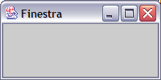
JFrame - Example
public class FrameSemplice extends JFrame {
public static void main(String[] args) {
JFrame f = new FrameSemplice();
f.show();
}
public FrameSemplice(){
super("Finestra");
setSize(200,100);
}
}
What happens when no setSize() ?

Slide 15
Window close
Clicking the button or
  Closes the window but
  DO NOT terminate the application
It is required to explicitly define the operation to be performed in response to window closure
E.g.
  setDefaultCloseOperation(
  JFrame.DISPOSE_ON_CLOSE);

Slide 16
Container Basic Features
setDefaultCloseOperation(bhvr): define the behavior upon window close
  EXIT_ON_CLOSE
  DO_NOTHING_ON_CLOSE
  DISPOSE_ON_CLOSE
  HIDE_ON_CLOSE
SetSize(int width, int height): defines the dimensions of the panel outside

Slide 17
COMPONENTS

Slide 18
Button
Button is a component: initiates action with the pressure event.
Button is created by the constructors:
  JButton(); creates a button without a text (without label)
  JButton(String); creates a button with a label containing the text.
it is a component → inherits all the methods of classes JComponent (javax.swing) and component (java.awt)‏
It is a container → inherits all methods of java.awt.container.class

Slide 19
Label
Constructors
  JLabel(String); create label with given text, aligned on the left
  JLabel(String, int); create label with given text, aligned:
    SwingConstants.LEFT
    SwingConstants.RIGHT
    SwingConstants.CENTER
Available methods:
  getText(), setText(String)
  getAlignement(), setAlignement(int)

Slide 20
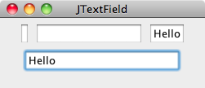

Text field
The text fields allows entering strings of text on a single line
Constructors:
  JTextField(String) initial content
  JTextField(int) required size in chars
  …
Example
add(new JTextField());
add(new JTextField("", 20));
add(new JTextField("Hello”));
add(new JTextField("Hello",30));

Slide 21
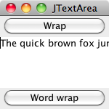
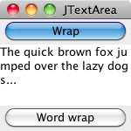
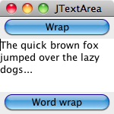
Text area
Manages text on several lines
Constructors
  JTextArea (int lines, int columns)
  JTextArea (String text, int l, int c)
Useful Metods:
  getText(), setText(String);
  append(String), insert(String, int);
  void setLineWrap(boolean)
  void setWrapStyleWord(boolean)

Slide 22
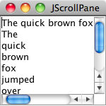
Scrollpane
JScrollPane is able to add scroll bars to a scrollable component (e.g. JTextArea)
Constructor:
  JScrollPane(Component );
Example:
  JScrollPane sp =
  new JScrollPane(
  new JTextArea(longText));

Slide 23
Checkbox, Options
Check boxes : JCheckBox(String, boolean)
Option buttons: JRadioButton(String, boolean)
Useful methods:
  void setSelected(boolean)
  boolean isSelected()
Mutual exclusion:
  Add RadioButton (or CheckBox) to ButtonGroup
  By default they are non-exclusive

Slide 24
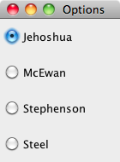
Example
public class Authors extends JFrame{
JRadioButton[] list = new JRadioButton[4];
public Authors() {
super("Select an author");
setSize(140, 190);
setDefaultCloseOperation(JFrame.EXIT_ON_CLOSE);
list[0] = new JRadioButton("Jehoshua", true);
list[1] = new JRadioButton("McEwan");
list[2] = new JRadioButton(”Stephenson");
list[3] = new JRadioButton("Steel");
JPanel panel = new JPanel();
ButtonGroup group = new ButtonGroup();
for (int i = 0; i < list.length; i++) {
group.add(list[i]);
panel.add(list[i]);
}
setContentPane(panel);
setVisible(true);
} public static void main (String args[]) {
Authors newLista = new Authors(); }
}

Slide 25
Dialog boxes
Used for short focused interactions
  Confirmation
  Input
  Message
  Options
Methods more efficient than input/output in order to read from keyboard
Class JOptionPane
  Several static methods for different types

Slide 26
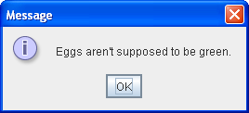
Dialog windows for confirmation
Every dialog is dependent on a root Frame component.
Example:
JOptionPane.showMessageDialog(frame, "Eggs aren’t supposed to be green.");

Slide 27
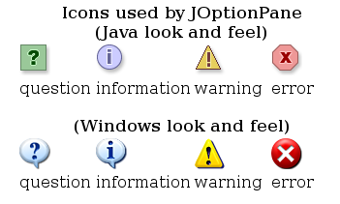
JOptionPane Features
Using JOptionPane, you can quickly create and customize several different kinds of dialogs. JOptionPane provides support for laying out standard dialogs, providing icons, specifying the dialog title and text, and customizing the button text.

Slide 28
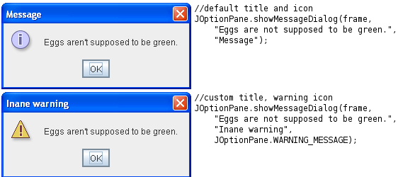
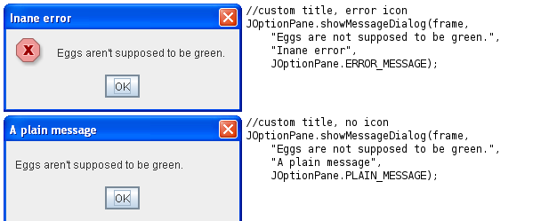
JOptionPane Features: examples

Slide 29
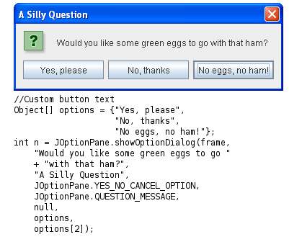
showOptionDialog
Displays a modal dialog with the specified buttons, icons, message, title, and so on. With this method, you can change the text that appears on the buttons of standard dialogs. You can also perform many other kinds of customization.

Slide 30
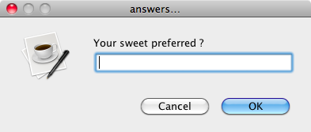
Input dialog
Methods
  String showInputDialog(Component, Object)
  String showInputDialog(Component, Object, String, int)‏
    Component: in which component appears window
    Object: Request message input
    String: title
    int: type of message (as in confirmation)‏
Example:
String answer = JOptionPane.showInputDialog(null,
“Your sweet preferred ?”, “answers…”, JOptionPane.QUESTION_MESSAGE);

Slide 31

Full example: visual counter
Model: a simple counter
public class Counter {
private int value;
public void increment(){
value++;
}
public void decrement(){
value--;
}
public int getValue(){
return value;
}
}

Slide 32

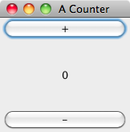

Visual Counter - View
public class View extends JFrame {
private JButton plus;
private JLabel value;
private JButton minus;
private Counter model;
public View(Counter c,
Controller controller){
… }
public void update(){
… }
}
Model

Slide 33

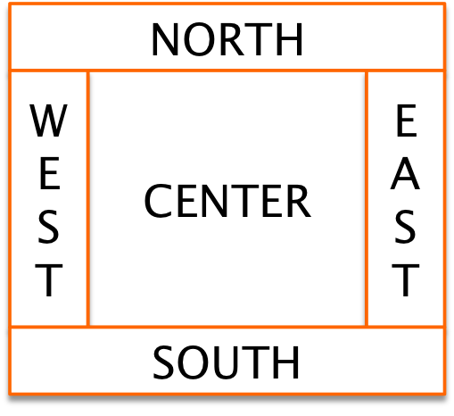
Visual Counter – View
public class View extends JFrame {
public View(Counter c, Controller controller){
setTitle("A Counter");
setSize(150,150);
setLayout(new BorderLayout());
plus = new JButton("+");
this.add(plus,BorderLayout.NORTH);
minus = new JButton("-");
this.add(minus,BorderLayout.SOUTH);
value = new JLabel("?");
value.setHorizontalAlignment(JLabel.CENTER);
this.add(value,BorderLayout.CENTER);
setVisible(true);

Slide 34


Visual Counter – View
setDefaultCloseOperation(JFrame.DISPOSE_ON_CLOSE);
model = c; // MODEL
plus.addActionListener(controller);
minus.addActionListener(controller);
controller.setView(this); // CONTROLLER --> VIEW
update();
}
public void update(){
String v = Integer.toString(model.getValue());
value.setText(v);
}
Model

Slide 35


Visual Counter – Controller
public class Controller
implements ActionListener {
private Counter model;
private View view;
public Controller(Counter m){ model = m; }
public void actionPerformed(ActionEvent e){
if(e.getActionCommand().equals("+")){
model.increment();
else
model.decrement();
view.update();
}
public void setView(View finestra) {
view = finestra;
}
}
Model

Slide 36
LAYOUT

Slide 37
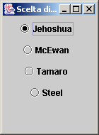
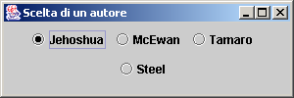
What is a layout?
All the former examples graphs, when resized, allow the relocation of the components:
this behavior is a necessity: Java adapts to many platforms (display in different way for different systems)
Solution in Visual Basic → available ‘absolut’(x,y)‏
Original (140 x 190)‏
Resized (300 x 100)‏

Slide 38
Layout managers
Determine the size and position of the components within a container
  Manage resize of containers
  Accounts for differences in OSs and font sizes
setLayout(LayoutManager m);
Absolute positioning is possible
  setLayout(null);
  setBounds() for each component

Slide 39
FlowLayout
It is the base layout of applications/graphics applets
Disposition: from left to right, starting from the left most corner in the top
Constructors:
  FlowLayout f=new FlowLayout();
  FlowLayout f=new FlowLayout(int align);
  FlowLayout f=new FlowLayout(int align, int hgap, int vgap);
Parameters:
  align: Alignment of basis (FlowLayout.LEFT, FlowLayout.RIGHT, FlowLayout.CENTER)‏
  hgap: Horizontal space between components (default: 3 px)‏
  vgap: Vertical space between components (default: 3 px)‏

Slide 40
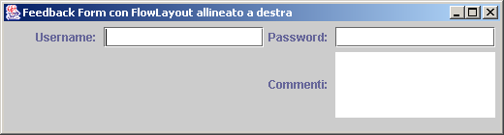
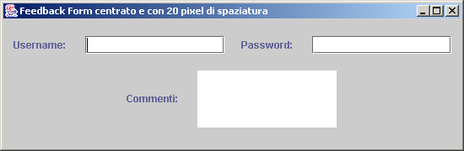
Example of FlowLayout (default in Java)‏
(FlowLayout.RIGHT)‏
(FlowLayout.CENTER,20,20)‏

Slide 41
GridLayout
Splits the screen in a grid of rows and columns
Filling: the box in the top left
Constructors:
  GridLayout(int rows, int cols);
  GridLayout(int rows,int cols,int hgap,int vgap);
Parameters:
  rows: number of row;
  cols: number of columns;
  hgap: Spacing (in pixels) between two horizontal boxes (default: 0 pixel)‏
  vgap: spacing (in pixel) between two vertical boxes (default: 0 pixel)‏

Slide 42
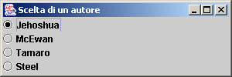
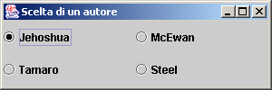

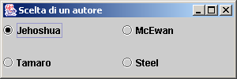

Example of GridLayout
4 row, 1 columns: distance 0
2 row, 2 columns: distance 0 pixel
(Distanza min = 0)‏
2 row, 2 columns: distance 10 pixel
(Min distance = 10)‏

Slide 43
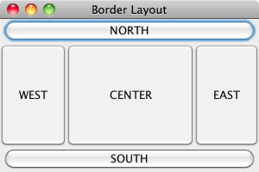
BorderLayout
Divide the container into five areas
  4 in the border 1 in the center
setLayout(new BorderLayout());
add("North",new JButton("NORTH"));
add("South",new JButton("SOUTH"));
add("East",new JButton("EAST"));
add(new JButton("WEST"),BorderLayout.WEST);
add(new JButton("CENTER"),BorderLayout.CENTER);

Slide 44
GridBagLayout
Extension of the grid layout (GridLayout)‏
  elements of the grid can be adjusted with mechanisms of personalization
Usage procedure:
  Create GridBagLayout object
  Create ‘constraint’ object (GridBagConstraints)
  For each component‏
  Define the adjustment
  Register the component-constraint link with the manager
  Add the component to the container

Slide 45
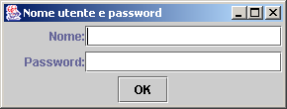
Exercise
To understand the meaning of regulations, try to create a component of this type:

Slide 46
GridBagConstraints in detail
The previous project can be seen in a schematic way in the following way :
JTextField zone
JLabel1 zone
Axis X
(0,0)‏
(1,0)‏
JLabel2 zone
(0,1)‏
(1,1)‏
JPasswordField zone
(0,2)‏
(1,2)‏
JButton “OK” zone
Axis Y

Slide 47
Regolation on GridBagConstraints (1)‏
Components are put in the cells at position (x, y)‏
"OK" button must occupy two cells: the other components are in a single cell
breadth of the components is variable (the label "name" occupies about 30% of line…)
Cells are positioned (the "OK" button is centered, etc.)

Slide 48
Regolation on GridBagConstraints (2)‏
Class GridBagConstraints has different fields:
  gridx - The initial gridx value.
  gridy - The initial gridy value.
  gridwidth - The initial gridwidth value.
  gridheight - The initial gridheight value.
  weightx - The initial weightx value.
  weighty - The initial weighty value.
  anchor - The initial anchor value.
  fill - The initial fill value.
  insets - The initial insets value.
  ipadx - The initial ipadx value.
  ipady - The initial ipady value.

Slide 49
Regolation on GridBagConstraints (3)‏
The values of fill are : BOTH, NONE, HORIZONTAL, VERTICAL
The values of anchor are: CENTER, NORTH, NORTHEAST, EAST, SOUTHEAST, SOUTH, SOUTHWEST, WEST, NORTHWEST
Therefore…
GridBagLayout grid = new GridBagLayout();
pannel.setLayout(grid);
GridBagConstraints Gbc = new GridBagConstraints();
JLabel label1 = new JLabel (“Name:”, JLabel.LEFT);
Gbc.gridx = 0;
Gbc.gridy = 0;
Gbc.gridwidth = 1;
Gbc.gridheigth = 1;
Gbc.weightx = 30;
Gbc.weigthy = 40;
Gbc.fill = GridBagConstraints.NONE;
Gbc.anchor = GridBagConstraints.EAST;
grid.setConstraints(Gbc, label1);
pannello.add(label1);

Slide 50
Java Events

Slide 51
Event Delegation Model
Since Java1.1
  Events are classified by type (MouseEvent, KeyEvent, etc.)
  Events are generated in components sources
  An object can be registered as listener (listener) of a type of event by sending a message to the component source

Slide 52
Event Delegation Model
Whenever an event occurs the AWT thread sends a message to all the registered listener objects (the event is passed as a parameter)
A listener object must implement the appropriate interface (to make possible the call-back)

Slide 53
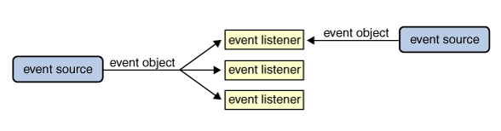
Event Delegation Model
java.util.EventListener
Multiple listeners can register to be notified of events of a particular type from a particular source. Also, the same listener can listen to notifications from different objects.
implements
aClass
aComponent
send_events_to
Listener
Event Source

Slide 54
Events
The events are represented by a hierarchy of classes. Each class is defined by the data representing that type of event.
Some of the classes that are a set of events (MouseEvent) MAY CONTAIN AN ID that identifies the exact event type.

Slide 55
Example
Click
2
A Button
1
addActionListener(ListenerObject)‏
addActionListener(Object)‏
new
An ActionEvent
3
ListenerObject
actionPerformed(AnActionEvent)‏
actionPerformed
(ActionEvent)‏
4

Slide 56
Events in Java: sources and types
Source
Event
Button
ACTION events → when the button is push
Box of choice
ELEMENT events → select/deselect
Menu
ACTION event → when you select a menu item;
ELEMENT event → when a selectable menu item is activated
Window
WINDOW events → when the window is activated, maximized, minimized,...
…

Slide 57
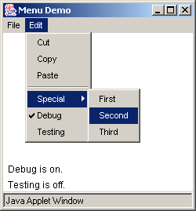
Difference between ‘selection - activation’
Activation → event of element
selection → event of action

Slide 58
Management of the events
Problem: We must make receptive interface
Events covered in Java :
  Action event → click a button
  Adjustment event → actions on scroll bars
  Focus event → point the mouse on a text field
  Item event → click on RadioButton, CheckBoxButton
  Key event → keyboard input
  Mouse event → click (not covered above)
  Mouse-motion event → Simple displacement of the mouse
  Window event → Enlarge, close a window

Slide 59
An example of management of the events (1/4)‏
import java.awt.*;
import java.awt.event.*;
import javax.swing.*;
public class MouseEvents extends JFrame implements MouseListener, MouseMotionListener {
int mouseX = 0, mouseY = 0;
public MouseEvents() {
super(“Mouse Events");
setSize(300,120);
setDefaultCloseOperation(EXIT_ON_CLOSE);
JPanel pannello = new JPanel();
pannello.addMouseListener(this);
pannello.addMouseMotionListener(this);
setContentPane(pannello);
setVisible(true);
}

Slide 60
An example of management of the events (2/4)‏
public void mouseClicked(MouseEvent me) {
mouseX = 0;
mouseY = 10;
System.out.println(“noted mouse click.");
}
public void mouseEntered(MouseEvent me) {
mouseX = 0;
mouseY = 10; // Position of the entry' = in the top left (under the edge of the frame)
System.out.println(“Mouse is in sensible zone.");
}
public void mouseExited(MouseEvent me) {
mouseX = 0;
mouseY = 10;
System.out.println(“Mouse is out of sensible zone.");
}

Slide 61
An example of management of the events (3/4)‏
public void mousePressed(MouseEvent me) {
mouseX = me.getX();
mouseY = me.getY();
System.out.println("Mouse push");
}
public void mouseReleased(MouseEvent me) {
mouseX = me.getX();
mouseY = me.getY();
System.out.println("Mouse release");
}
public void mouseDragged(MouseEvent me) {
mouseX = me.getX();
mouseY = me.getY();
System.out.println("You are dragging the mouse in personal data " + mouseX + ", " + mouseY);
}

Slide 62
An example of management of the events (4/4)‏
public void mouseMoved(MouseEvent me) {
System.out.println(" You are moving the mouse in personal data " + me.getX() + ", " + me.getY());
}
public static void main (String args[]) {
JFrame frame = new MouseEvents();
}
}

Slide 63
Managing events
The principle underlying the events is quite similar to the exceptions :
  A class declares which event is able to deal with (one or more) → implements one or more interfaces
  It joins the listener set of the components that are source of events (JButton, JTextField, etc..) → aButton.addActionListener(controller)
    Pay attention! You're implementing interfaces, so you must overwrite all methods of those interfaces!

Slide 64
How to manage the events in Java
class FrameWithEvents extends JFrame implements InterfaceWithEvents {
JComponent componentSourceofEvents =
new JComponent();
componentSourceOfEvents.addListener(this);
void methodOfTheInterfaceWithEvents() {…}
void anotehrMethodOfTheInterfaceWithEvents() {…}
}//end class

Slide 65
Listener Interfaces (1)
ActionListener → Methods to override :
  void actionPerformed (ActionEvent evt)‏
FocusListener → Methods to overwrite :
  void focusGained (FocusEvent evt)‏
  void focusLost (FocusEvent evt)‏
ItemListener → Methods to rewrite :
  void itemStateChanged (ItemEvent evt)‏

Slide 66
Listener Interfaces (2)‏
4.MouseListener (→ Methods to rewrite :
  void mouseClicked (MouseEvent evt)‏
  void mouseEntered (MouseEvent evt)‏
  void mouseExited (MouseEvent evt)‏
  void mousePressed (MouseEvent evt)‏
  void mouseReleased (MouseEvent evt)‏
5.MouseMotionListener (→ Methods to rewrite :
  void mouseDragged (MouseEvent evt)‏
  void mouseMoved (MouseEvent evt)‏

Slide 67
Listener Interfaces (3)‏
6. KeyListener → Methods to rewrite :
  void keyPressed (KeyEvent evt)‏
  void keyReleased(KeyEvent evt)
  void keyTyped(KeyEvent evt)‏
7. WindowListener (→ Methods to rewrite :
  void windowActivated(WindowEvent evt)‏
  void windowClosed (WindowEvent evt)‏
  void windowClosing (WindowEvent evt)‏
  void windowDeactivated (WindowEvent evt)‏
  void windowDeiconified (WindowEvent evt)‏
  void windowIconified (WindowEvent evt)‏
  void windowOpened (WindowEvent evt)‏

Slide 68
Add a listener
Who’s the listener ?
  A separate controller object
button.addActionListener( controller );
  An adapter anonymous class relaying to a method
button.addActionListener(new ActionListener(){public void actionPerformed(){
doClick() } }
  The same container (e.g. JFrame)
button.addActionListener( this );

Slide 69
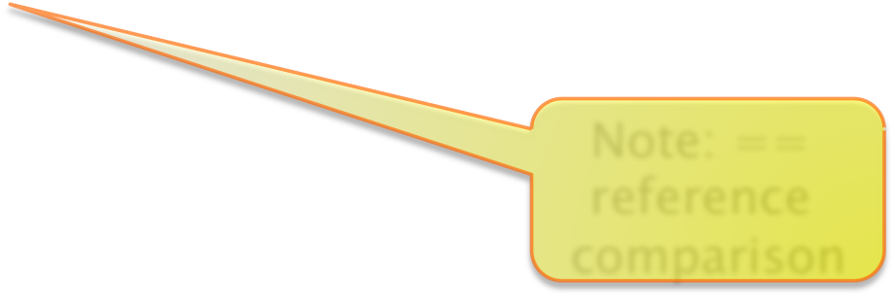
Handle the event
Identify the source of events
  May be implicit in the anonym dispatcher
Object ob = evt.getSource();
if (ob == button ){
// perform event handling
}
Use event additional information
  E.g. mouse positio
Note: == reference comparison

Slide 70
Handle the event
All methods accept an event as argument
  The argument (KeyEvent, MouseEvent, etc.)‏ provides methods to get information about the event:
Examples
  ActionListener
    String getActionCommand(): returns a string identifying the component which generated the command
    String paramString(): returns a string describing the event type (common to all event objects)‏

Slide 71
Methods associated with the event objects
  ItemEvent:
    int getStateChange(): return SELECTED or DESELECTED on whether the RadioButton or the CheckBox is turned or less
  KeyEvent:
    char getKeyChar(): Returns the character typed by keyboard → also useful in the case of a case from the keyboard
    int getKeyCode(): Unicode returns the code of the character
    String getKeyText(): STRESSES the events due to keys as “Insert”, “PageUp”, etc. [NOT modifiers as “Shift” or “Ctrl”]
  WindowEvent:
    Possible events:
    WINDOW_ACTIVATED
    WINDOW_CLOSED
    WINDOW_CLOSING
    WINDOW_DEACTIVATED
    WINDOW_DEICONIFIED
    WINDOW_GAINED_FOCUS
    WINDOW_ICONIFIED
Possible methods:
Window getWindow()‏
Window getOtherWindow()‏

Slide 72
For Who has patience (and desire)...
Exercise:
Write a program Calcolator.java that realizes the functionality of a simple calculator. Requirements of the graphics interface:
  10 buttons with the figures from 0 to 9 prepared as in a traditional calculator;
  Buttons relating to the operations of sum, subtraction, multiplication and division;
  button “CE” To cancel the last number wrought ;
  button “C” To clear any operation ;
  button“=” To claim the result ;
  button “.” To insert decimal places;
  label to represent the display the calculator.

Slide 73
Observation
Model the behavior of a "simple" Pocket calculator is not a simple activity : in order to make this exercise not too heavy from the point of view of the algorithms, you can simplify the following algorithm of calculation of arithmetic expressions introduced with the following hypotheses:
  The expressions involve always and only 2 operandi ;
  The user inserts always and only the first working operator, then the second working and the key "="; the result becomes the first working operator for the next operation
  The only exception to the rule (2) is the case for buttons "C", "EC" AND "off" that can be pressed at any time.

Slide 74
Algorithm of management (1)‏
state = NO_OPERATOR
buffer = 0
For each button pressed :
if the state is NO_OPERATOR then
If the button pressed is a figure then
queues to buffer the figure
view the buffer
If the button pressed is a sign then
operator1 = buffer
operand = sign
buffer = 0
state = AN_OPERATOR
if the button pressed is C or CE
buffer = 0
view the buffer
otherwise, if the State is AN_OPERATOR then
If the button pressed is a figure then
queues to buffer the figure
view the buffer
If the button pressed is “=” then
operator2 = buffer
Calculate the term operatore1, a sign, operatore2 and visualizzala buffer = 0
state = NO_OPERATOR
?

Slide 75
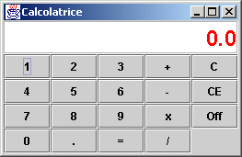
Algorithm of management (2)‏
If the button pressed is C
buffer = 0
view the buffer
state = NO_OPERATOR
If the button pressed is CE
buffer = 0
view the buffer

Slide 76
GUI testing
To execute a test of a GUI there are two possible approaches:
  Test from outside
  Test from within

Slide 77
Test from outside
Test from outside
  Through the Operating System events are sent to the application emulating the user behavior
  Pro: realistic approach
  Cont: complex, OS dependent
  There are specific tools that are able to capture operations performed by a user and to replay them later

Slide 78
Test from within
Test from within
  Specific methods can be invoked on graphical component to achieve a similar effect to that of a real usage (e.g. doClick() on a button)
  Pro: simple, OS independent
  Con: not realistic, not full interaction
  Con: classes must be designed for testability
    E.g. let selected attribute visible

Slide 79
GUI Test - Example
public void testGUI(){
SimpleCassa gui = new SimpleCassa();
gui.setVisible(true);
gui.input.setText("P001");
gui.pulsante.doClick();
gui.input.setText("P002");
gui.pulsante.doClick();
gui.input.setText("P001");
gui.pulsante.doClick();
gui.input.setText("CLOSE");
gui.pulsante.doClick();
String output = gui.output.getText();
assertTrue("output sbagliato",
output.indexOf("Totale: 7.5")>-1);
}

Slide 80
Graphics

Slide 81
Direct drawing
Two elements are required to draw directly :
  Method void paint(Graphics g)
    Must be redefined in derived classes
    Invoked by O.S.
  Class Graphics
    Provides methods to draw

Slide 82
Class Graphics
Is the class that supports the capacity graphics applications, which draw lines, forms, characters and present images on screen, by means of a series of methods .
The method paint() provides an object graphics acting on which draws on the screen.
  It isn’t necessary to create an instance of the class graphics to draw on the screen

Slide 83
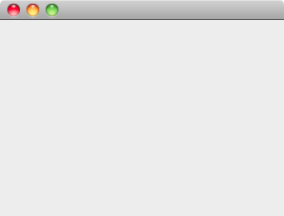
Class Graphics
The coordinate system:
  Origin in the top left corner
  X increase moving to the right
  Y increase moving downwards
x
y

Slide 84
Graphics methods: lines
drawLine(x1,y1,x2,y2)
  Draw a line between two points
drawRect(x,y,width,height)
  Draw a rectangle (x,y) is upper left corner
  Size is defined by width and height
fillRect()
  Same as above but rectangle is solid filled

Slide 85
Graphics methods: rectangles
drawRoundRect(x, y, width, height, arcWidth, arcHeight)
  Draw a rectangle with rounded angles
fillRoundRect(x, y, width, height, arcWidth, arcHeight)
  Same as above but with solid filled shape
arcWidth
arcHeight

Slide 86
Graphics methods: ellipses
drawOval(x,y,width,height)
  Draw an ellipse inscribed in a rectangle located at (x,y) with the given size
drawArc(x,y,width,height,start,stop)
  Draw an arc of an ellipse starting at start degrees and stopping at stop degrees
Also available:
  fillOval()
  fillArc()
(x,y)
stop
start
height
width

Slide 87
Graphics methods: strings
drawString(str,x,y)
  Draw a string starting at point (x,y)
drawChars(chars, offset, length, x, y)
  Draw a char array starting at point (x,y)
  Offset is the first char to draw
  Length is the number of chars to draw
The string
(x,y)

Slide 88
Draw lines and squares
To draw a line
  g.drawLine(25, 25, 75, 75);
To Draw a rectangle, specifying the coordinated point in the top left, width and length:
  g.drawRect(20, 20, 60, 60);
  g.fillRect(120, 20, 60, 60);
To Draw a rectangle, specifying the coordinated point in the top left, width and length:
  g.drawRoundRect(20,20, 60,60, 10,10);
  g.fillRoundRect(120,20, 60,60, 20,20);

Slide 89
Draw polygons
A polygon requires a set of points defined as two x and y arrays:
  int x[ ] = {39,94,97,142,53,58, 26};
  int y[ ] = {33,74,36,70,108,80, 106};
  int points = x.length;
  g.drawPolygon(x,y,points);
..or as instances of the class polygon:
  Polygon poly = new Polygon(x,y,points);
  g.fillPolygon(poly);
The polygon is closed automatically
  drawPolyline() allows to have open polygons.
Points can be added to a Polygon
  poly.addPoint(20,35);

Slide 90
Draw ellipses and arcs
To draw circles or ellipses using the oval .
  g.drawOval(20, 20, 60, 60);
  g.fillOval(120, 20, 100, 60);
Arcs are defined as pieces of ellipses with the method drawArc()
  An ellipsis must be defined plus the starting and ending angles. Which are defined counterclockwise (90 vertical axis ).
  g.drawArc(20, 20, 60, 60, 90, 180);
  g.fillArc(120, 20, 60, 60, 90, 180);

Slide 91
Draw strings
To draw strings use:
  g.drawString("Hello", 50, 50);
..or draw an array of chars:
  char[] chars = new char[]{'A','B','C','.','Z'};
  g.drawChars(chars,0,chars.length,80,70);

Slide 92
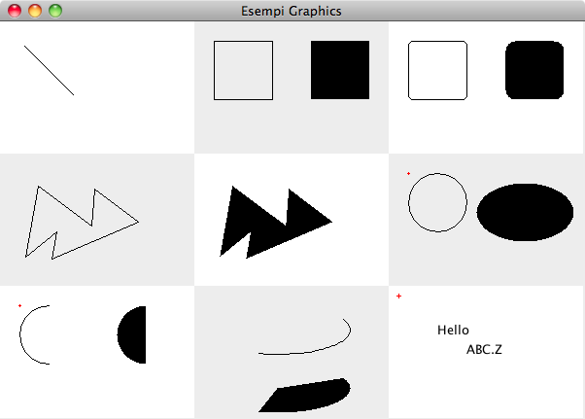
Examples

Slide 93
Repaint
Method paint() is invoked by OS when needed
  E.g. window resize, de-iconify
Method repaint() signals that window contents must be updated
  Later OS will invoke paint()
This method is essential to update the view when something is changed

Slide 94
Color management
The management of colors is performed through class Color.
  Colors are encoded on 24 bit; each color and consists of a combination of red, green and blue .
  Each component is represented with a whole number between 0 and 255.
There are class constants defined for the main colors.

Slide 95
Color management
For windows (JFrame):
  setBackground(Color c)
    Sets the window internal background
  setForeground(Color c)
    Sets the components foreground color
For Graphics:
  setColor(Color c)
    Sets the color for all the successive drawing operations

Slide 96
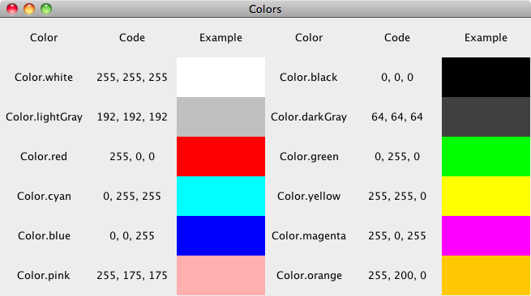
Color management

Slide 97
Font management
Fonts are represented by class Font
Constructor
  Font(String face, int attrs,
  int size)
Parameters
  Face is the name of the font e.g. “TimesRoman”
  Attrs represent attributes e.g. Font.BOLD
  Size is expressed in points

Slide 98
Font management
To get information about a font:
  getFont(): returns the current font
  getName(): returns font name
  getSize(): returns the font size
  getStyle():, Return the style of font
  isPlain()‏, isBold() , ‏isItalic(): return the font modifications
For more information more specific on the individual font use the class FontMetrics.

Slide 99
FontMetrics
Main methods are:
  stringWidth(): width in pixels of a given string
  charWidth(): amplitude of a char
  getAscent()
  getDescent()
  getLeading()
  getHeight()
Ag
Leading
Ascent
Height
Baseline
Descent

Slide 100
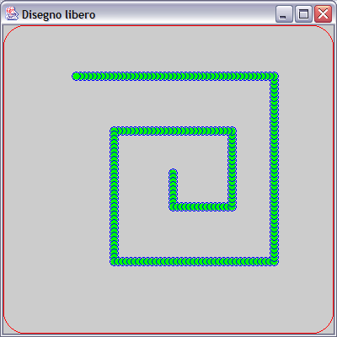
Example

Slide 101
Example
public class Drawing extends JFrame{
int x;
int y;
public void paint(Graphics g){
Rectangle b = getBounds();
g.setColor(Color.RED);
g.drawRoundRect(4,30,
b.width-9,b.height-35,50,50);
g.setColor(Color.BLUE);
g.drawOval(x,y,10,10);
g.setColor(Color.GREEN);
g.fillOval(x+1,y+1,9,9);
}
}
g covers all window area, including borders

Slide 102
Events
public class Drawing implements KeyListener{
public void keyPressed(KeyEvent e) {
if(e.getKeyCode()==KeyEvent.VK_DOWN){
moveXY(0,5);
}
// …
}
void moveXY(int deltaX, int deltaY){
x+=deltaX;
y+=deltaY;
this.repaint();
}
}

Slide 103
Considerations
The repaint operation does not erase the window
  Therefore we have the trail effect
We need to explicitly erase the content of the window:
  Rectangle bounds = getBounds();
  g.clearRect(0,0,bds.width,bounds.height);

Slide 104
Advices
Define a method paint on an empty (e.g. without borders) compoment
DO NOT override method paint() on a frame containing components
Usually a JPanel is a good candidate to override method paint()

